Slide 1
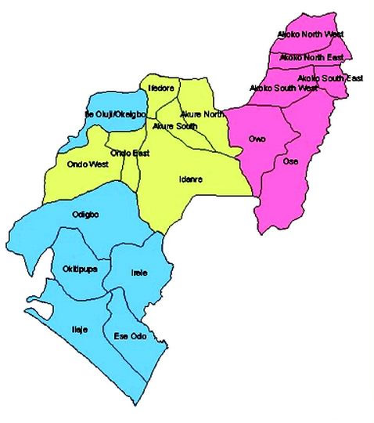
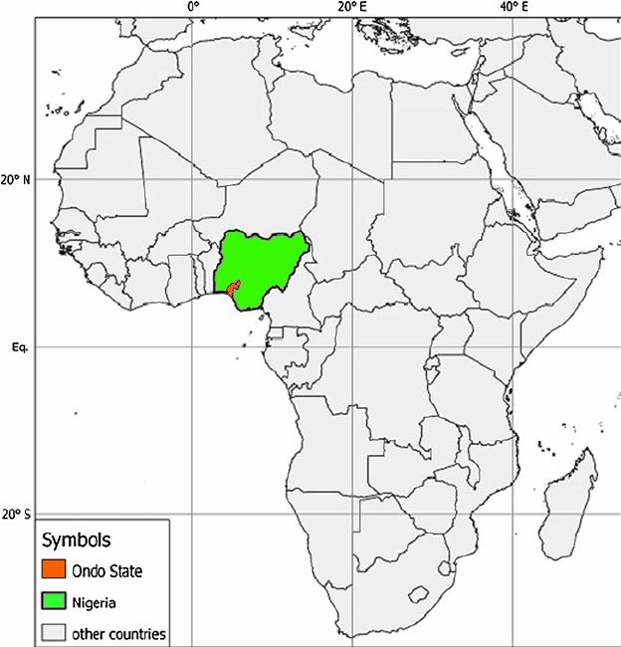
Opportunities in Blue Economy
Ondo State, Nigeria
(Work is the Antidote to Poverty)

Slide 2
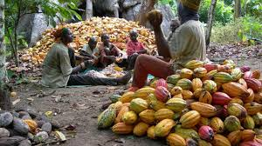
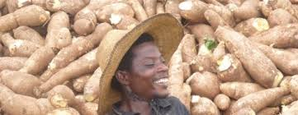
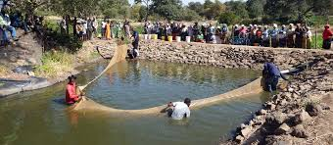
Geography
Located in Southwest of Nigeria and a transit route to the North and Eastern parts of the Country
15,500 square km land mass
4.5Million Population with 70% below 22 years
Economic Positioning
75km Atlantic Coastline and fishery communities
Tropical Climate
Over 150,000ha fertile Agricultural Land
Highly Educated Citizen
7 Higher Institutions of Learning
Highly Peaceful Niger-Delta State

Slide 3
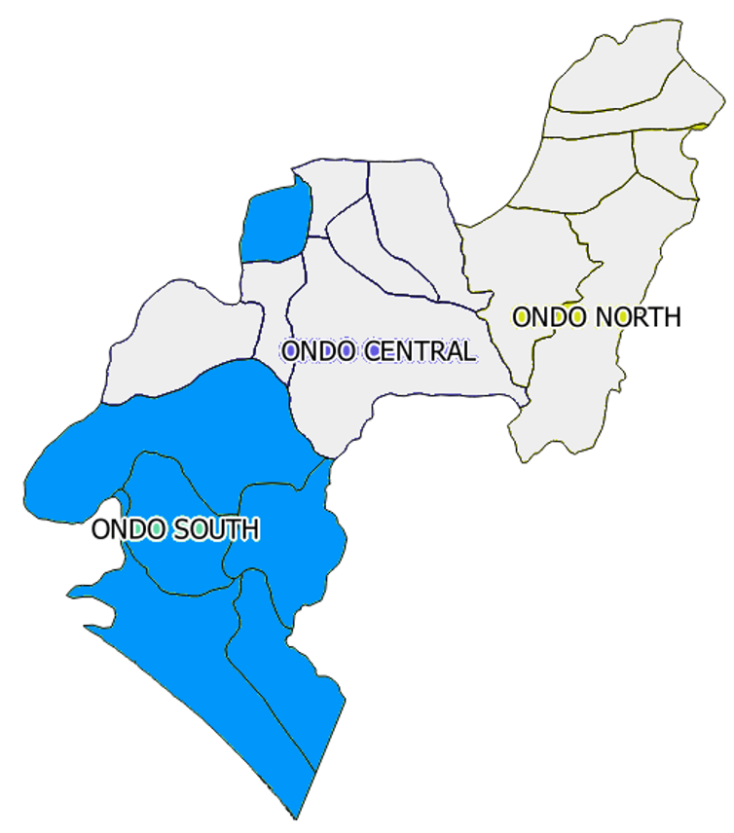
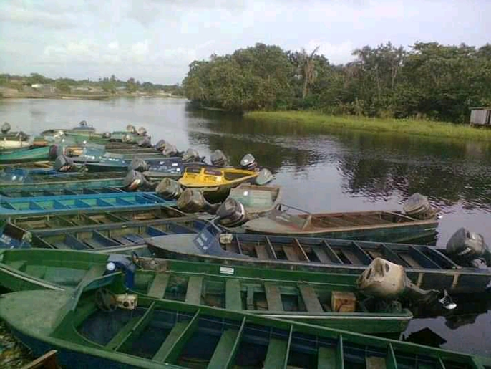
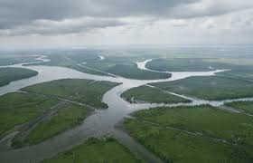
Ondo South Potentials
Natural riverine habitat
Navigable waterways
Direct access to Lagos waters and ports
Artisanal aquaculture livelihood
Boat building and sailing
Ready fit for large scale blue economy

Slide 4
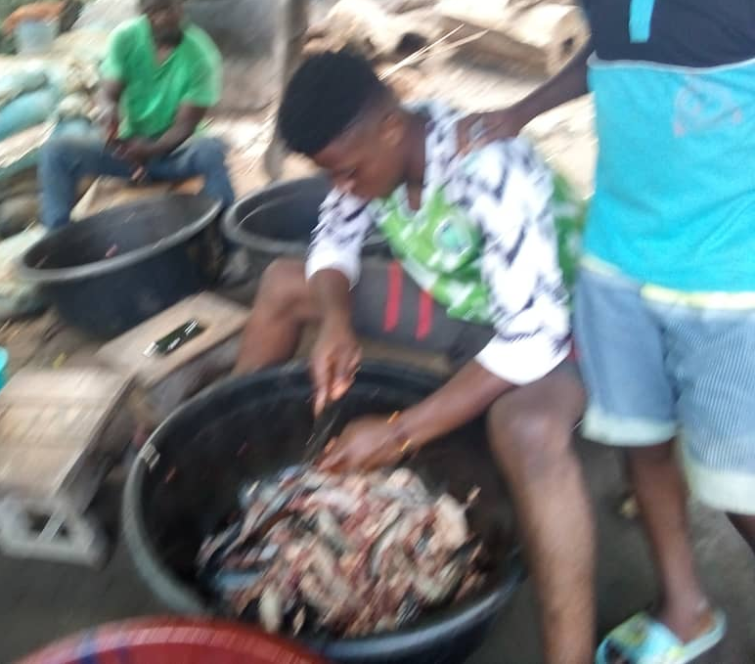
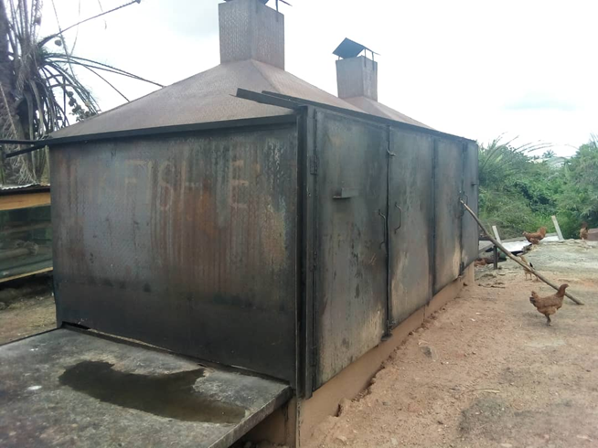
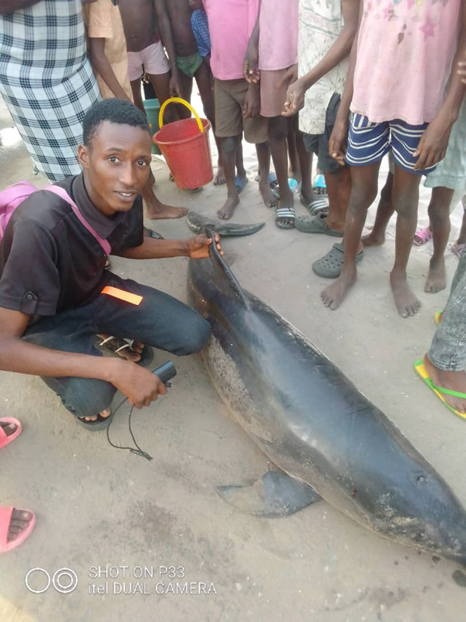
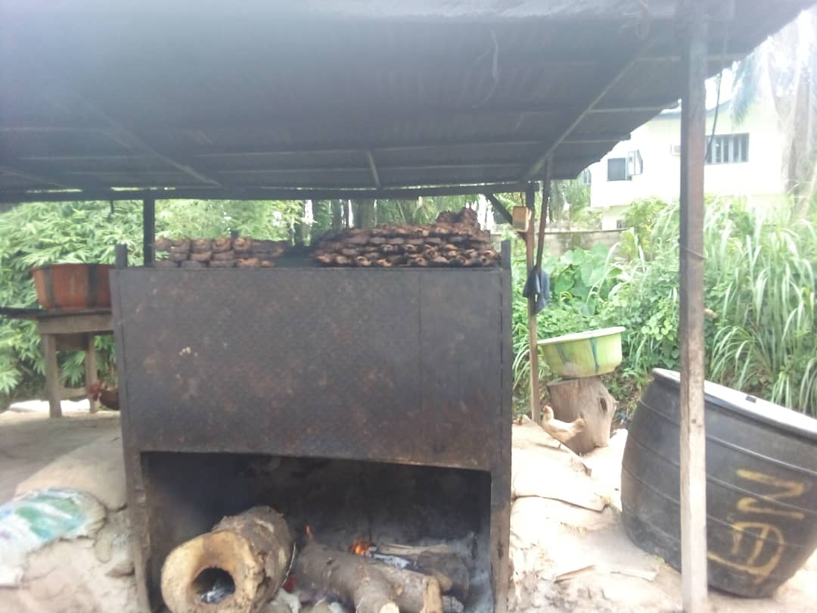
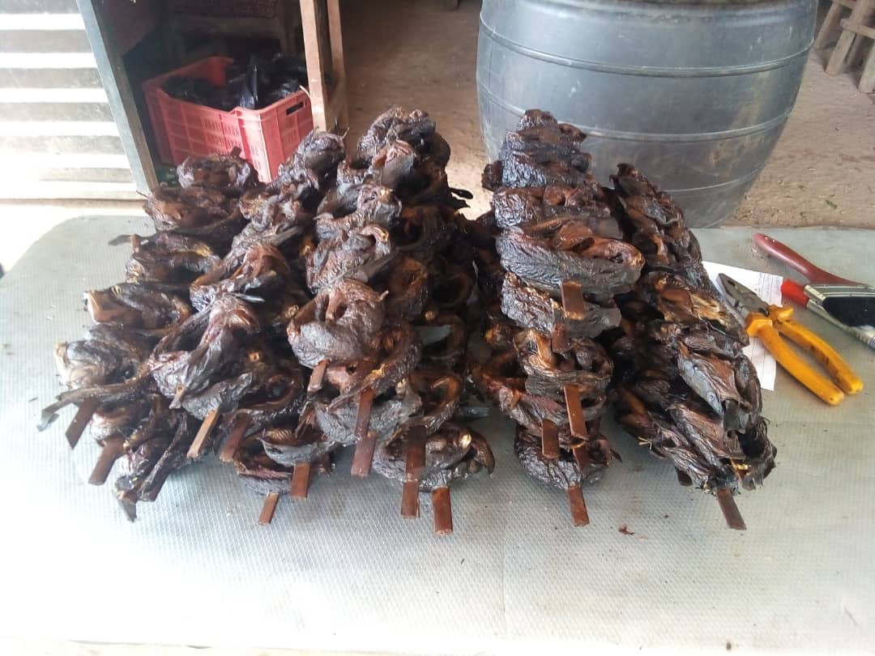
Ondo South Potentials
Established fish processing trade
Over 80 fishing communities
Sea and inland fishing skills
Variety of aqua products
Catfish, croaker, sole snapper, mixed fish, and shrimp

Slide 5
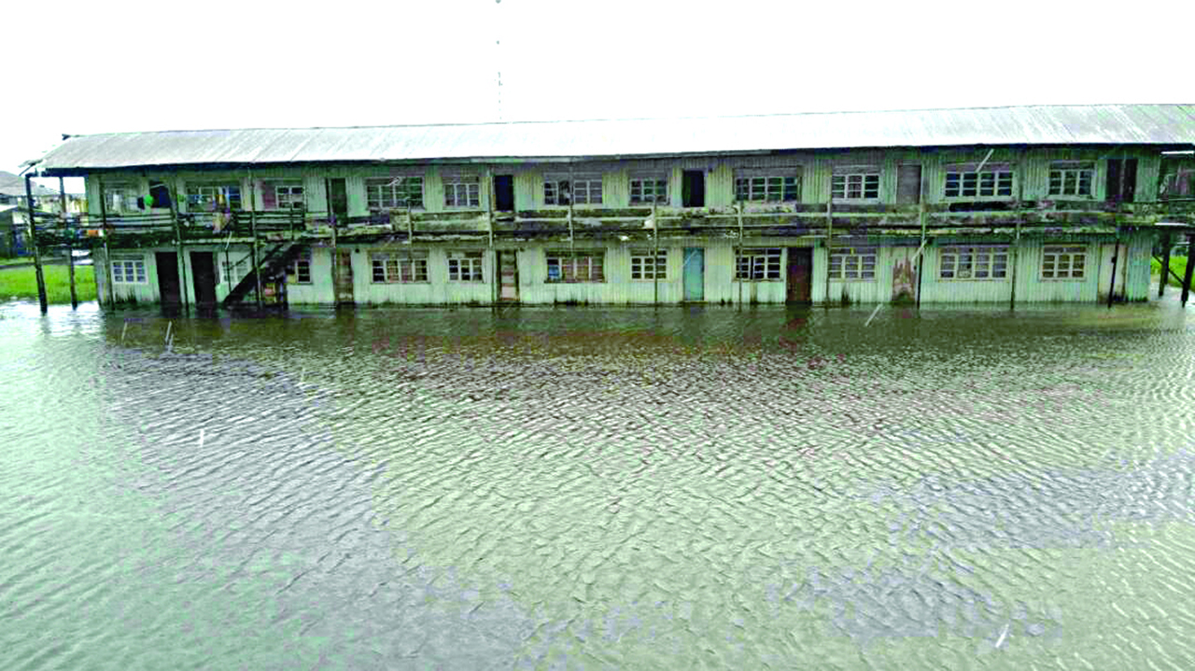
Challenges
Low skill fishing techniques
Lack of financial means for modern fishing equipment
Fishing boats limited to near offshore
Near shore poaching by trawlers
Entrepreneurial activities – family dependent
Inadequate literacy level
Current fishing process unappealing to educated family members
Cold storage challenges due to poor infrastructure (power)
Environmental impact of climate change on some communities

Slide 6
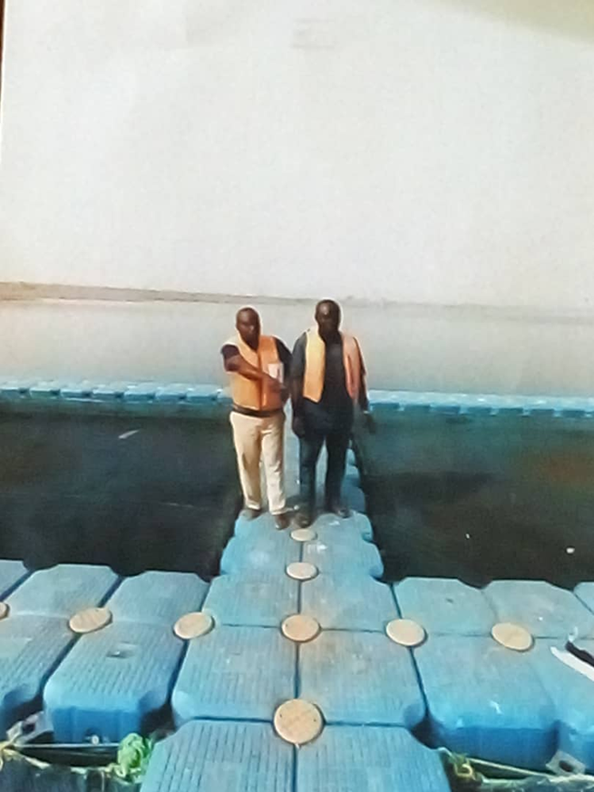
Opportunities
Development of aqua farms both sea and in-land
Modern fish storage and processing facility
Fish & Shrimps shipping and packaging system for export
Training facility in modern fishery
Facilitation of investment in fishing equipment

Slide 7
Blue Infrastructure – Deep Sea Port
Port Ondo (Deep Sea Port)
Ongoing approval towards establishment of a Deep Sea Port
Deepest natural draft in the country
Direct import/export of goods and products
Dedicated Mining Product Terminal
Well planned access to location
Nearby Free Trade Zone

Slide 8
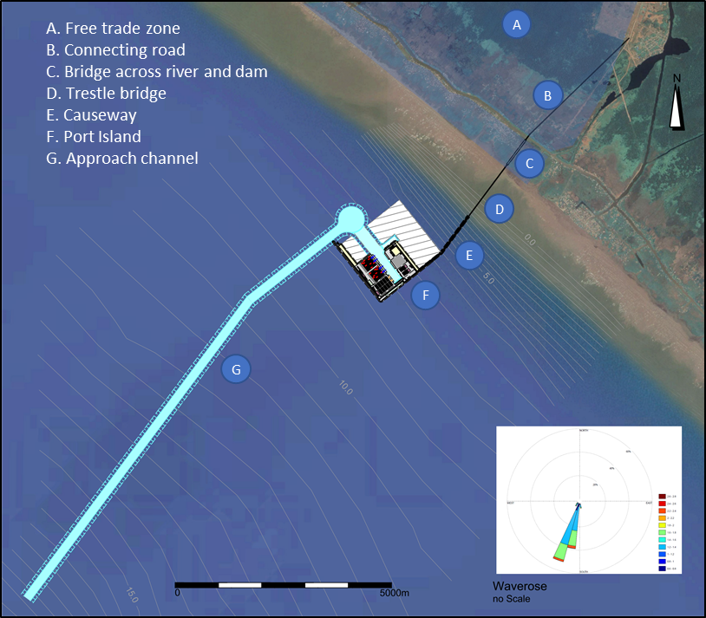
Blue Infrastructure – Deep Sea Port
Port of Ondo (Deep Sea)
Artificial island for direct berthing of bigger capacity vessels
Connects to the shore via a 2km bridge
Road, rail
Adjourning Free Trade Zone (Ondo Industrial City)
Estimated Cost: USD 2.0Billion
Jetties: 2x 400m
Berths:
North end: 1x 240m; 1x 260m; 3x 200m
South end: 4x 600m; 1x 260m

Slide 9
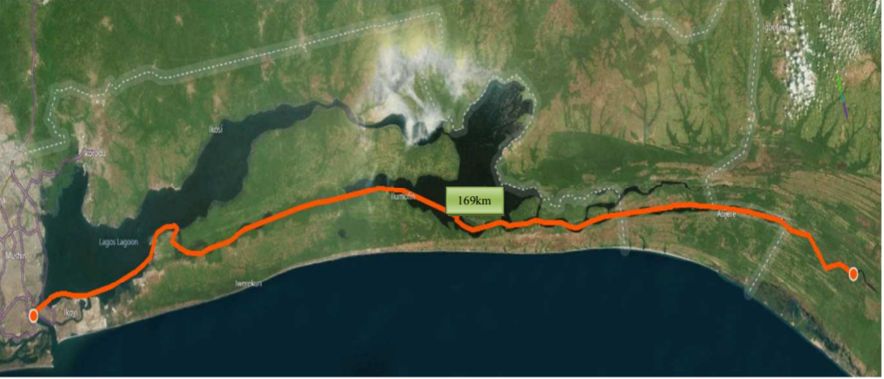
Blue Infrastructure – Inland Port
Alape Inland Port
170km direct water access to Lagos Ports
Relief for Lagos Port Congestion
Suitable for Barges and small to medium vessels
Container storage, loading and offloading
Easier access to hinterland Nigeria
River Alape to Lagos waterway is navigable year-round
Port will support exploitation of minerals in Ondo State
Silica sand, kaolin, bitumen
Supports shipment of cash crops from Osun, Ekiti, Ogun, Ondo and Edo States
Port will reduce the daily pressure from heavy trucks on Ore-Shagamu road

Slide 10
Conclusion
Ondo is prime for blue economy
Natural environment for aquaculture development
Blue infrastructure in support of Nigerian economy

Slide 11
One-stop Investor’s Contact
Ondo State Development & Investment Promotion Agency – ONDIPA
Information on Investment Opportunities
Support on local information and regulations
Business to business contacts
www.ondipa.org
+2348066480160; +234 8034002234

